Slide 1
Don’t Call it iteracy
Kensington Aldridge Academy
Staff Conference
14 July 2014
Twitter: @RealGeoffBarton
Download this presentation at www.geoffbarton.co.uk
(Presentation number 132)

Slide 2
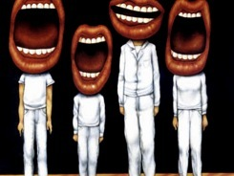
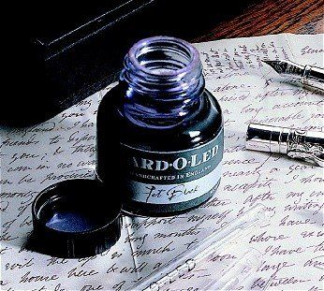

Slide 3
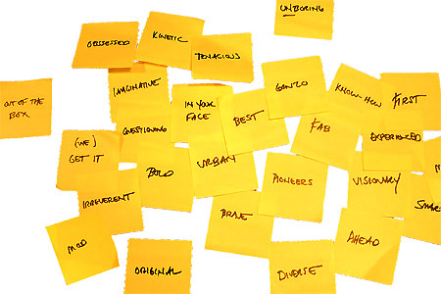
Approach:

Slide 4
The Matthew Effect
(Robert K Merton)

Slide 5
The rich shall get richer and the poor shall get poorer
Matthew 13:12

Slide 6
“The word-rich get richer while the word-poor get poorer” in their reading skills
(CASL)

Slide 7
The Literacy Club

Slide 8
Implications …

Slide 9
Become a Year 11 writer again
… for five minutes

Slide 10
Task:
Describe the room we are in

Slide 11
Q:
?
Unconfident
Confident
Irrespective of background

Slide 12
A:
Teach them

Slide 13
Provocations:
We haven’t done literacy
It’s all about the classroom
Knowledge and instruction may be more important than we realised
Remember the “Matthew Effect”

Slide 14
Talking Point
Respite
What’s new? What’s familiar?
Implications for you and your subject?

Slide 15
5 key ingredients
Then teach you something
Then reflection

Slide 16
Understand the significance of exploratory talk
Model good talk – eg connectives
Re-think questioning – ‘why & how’, thinking time, and no-hands-up
Consciously vary groupings
Get conversation into the school culture

Slide 17
DEMO

Slide 18
Focus: speaking in public

Slide 19
Barriers:
Lack of confidence
Lack of structure
Lack of depersonalised tone

Slide 20
Task: why school uniform crushes our individuality

Slide 21
Stance, notes, pen
Number points
Be repetitive
Sentence functions
Confidence
Structure
Depersonalised tone
Avoid I / me
Use ‘so’, ‘because’, ‘however’ & ‘therefore’

Slide 22
Talking Point
Understand the significance of exploratory talk
Model good talk – eg connectives
Re-think questioning – ‘why & how’, thinking time, and no-hands-up
Consciously vary groupings
Get conversation into the school culture
What are the main types of talk needed in your subject?
Barriers?
So what could you do?

Slide 23
Teach reading – scanning, skimming, analysis
Read aloud and display
Teach key vocabulary
Demystify spelling
Teach research, not FOFO

Slide 24
DEMO

Slide 25
SKIMMING

Slide 26
The climate of the Earth is always changing. In the past it has altered as a result of natural causes. Nowadays, however, the term climate change is generally used when referring to changes in our climate which have been identified since the early part of the 1900's . The changes we've seen over recent years and those which are predicted over the next 80 years are thought to be mainly as a result of human behaviour rather than due to natural changes in the atmosphere.

Slide 27
The best treatment for mouth ulcers. Gargle with salt water. You should find that it works a treat. Salt is cheap and easy to get hold of and we all have it at home, so no need to splash out and spend lots of money on expensive mouth ulcer creams.

Slide 28
Lexical v Grammatical Words

Slide 29
Urquhart castle is probably one of the most picturesquely situated castles in the Scottish Highlands. Located 16 miles south-west of Inverness, the castle, one of the largest in Scotland, overlooks much of Loch Ness. Visitors come to stroll through the ruins of the 13th-century castle because Urquhart has earned the reputation of being one of the best spots for sighting Loch Ness’s most famous inhabitant.

Slide 30
Urquhart castle is probably one of the most picturesquely situated castles in the Scottish Highlands. Located 16 miles south-west of Inverness, the castle, one of the largest in Scotland, overlooks much of Loch Ness. Visitors come to stroll through the ruins of the 13th-century castle because Urquhart has earned the reputation of being one of the best spots for sighting Loch Ness’s most famous inhabitant.

Slide 31
Urquhart castle is probably one of the most picturesquely situated castles in the Scottish Highlands. Located 16 miles south-west of Inverness, the castle, one of the largest in Scotland, overlooks much of Loch Ness. Visitors come to stroll through the ruins of the 13th-century castle because Urquhart has earned the reputation of being one of the best spots for sighting Loch Ness’s most famous inhabitant.

Slide 32
Urquhart castle is probably one of the most picturesquely situated castles in the Scottish Highlands. Located 16 miles south-west of Inverness, the castle, one of the largest in Scotland, overlooks much of Loch Ness. Visitors come to stroll through the ruins of the 13th-century castle because Urquhart has earned the reputation of being one of the best spots for sighting Loch Ness’s most famous inhabitant.

Slide 33
Urquhart castle is probably one of the most picturesquely situated castles in the Scottish Highlands. Located 16 miles south-west of Inverness, the castle, one of the largest in Scotland, overlooks much of Loch Ness. Visitors come to stroll through the ruins of the 13th-century castle because Urquhart has earned the reputation of being one of the best spots for sighting Loch Ness’s most famous inhabitant.

Slide 34
SCANNING

Slide 35
Where did the first cell phones begin?
Name 2 other features that started to be included in phones
Why are cell phones especially useful in some countries?

Slide 36
Where begin?
Two features?
Some countries?
Cellular telephones
The first cellular telephone system began operation in Tokyo in 1979, and the first U.S. system began operation in 1983 in Chicago. A camera phone is a cellular phone that also has picture taking capabilities. Some camera phones have the capability to send these photos to another cellular phone or computer. Advances in digital technology and microelectronics has led to the inclusion of unrelated applications in cellular telephones, such as alarm clocks, calculators, Internet browsers, and voice memos for recording short verbal reminders, while at the same time making such telephones vulnerable to certain software viruses. In many countries with inadequate wire-based telephone networks, cellular telephone systems have provided a means of more quickly establishing a national telecommunications network.

Slide 37
CLOSE READING

Slide 38
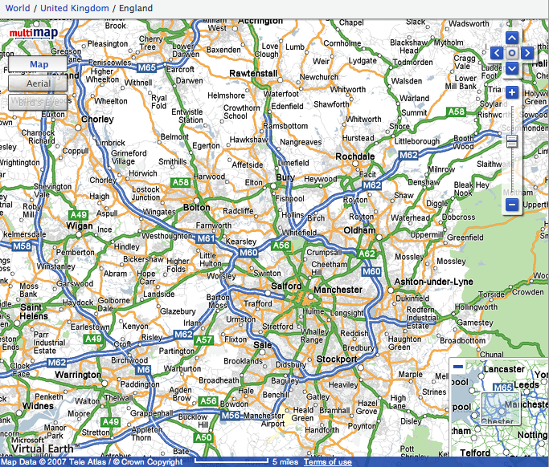

Slide 39
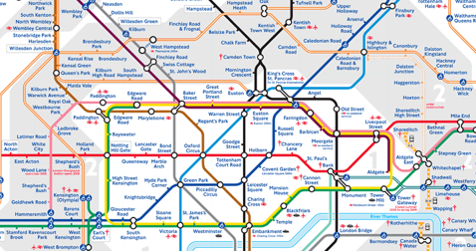
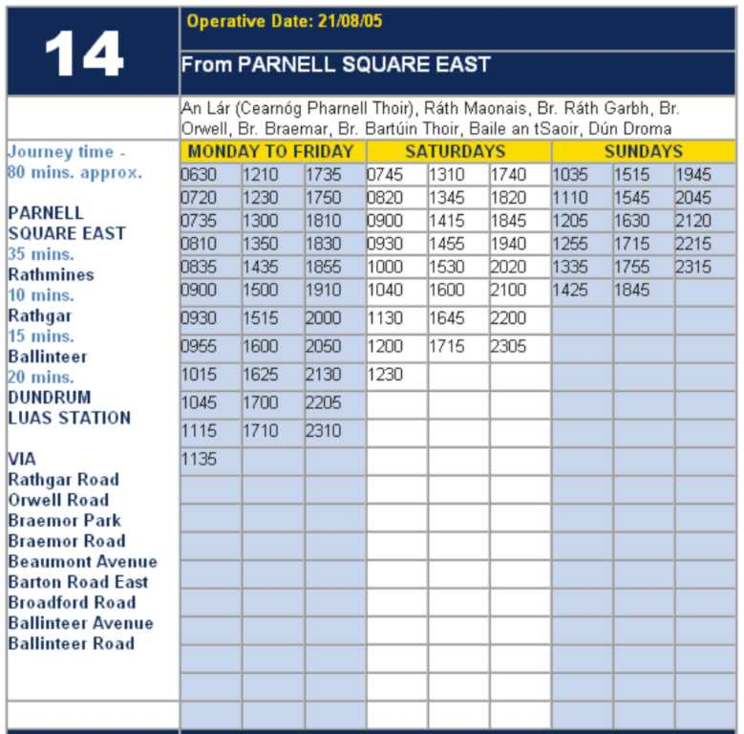
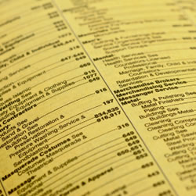

Slide 40
RESEARCH SKILLS

Slide 41
Research the life of
Martin Luther King

Slide 42
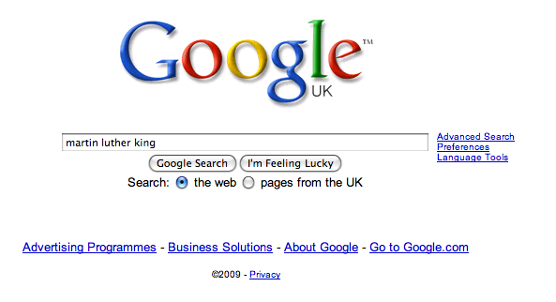

Slide 49
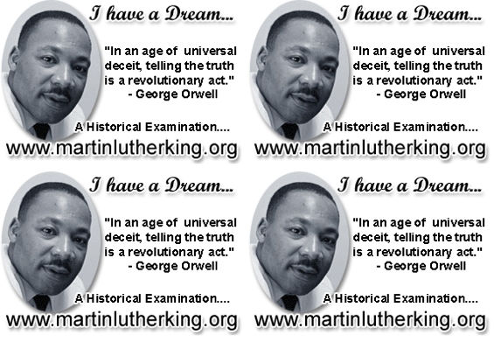

Slide 50
DEMYSTIFYING
SPELLING
3
Notes:
7 spellings: Government – February – parliament – separate – believe – necessary - accommodation

Slide 51
1 - SOUNDS

Slide 52
Government

Slide 53
February

Slide 54
Parliament

Slide 55
2 -VISUALS

Slide 56
Se-para-te
Be-lie-ve

Slide 57
3 - MNEMONICS

Slide 58
necessary

Slide 59
accommodation

Slide 61
Talking Point
Teach reading – scanning, skimming, analysis
Read aloud and display
Teach key vocabulary
Demystify spelling
Teach research, not FOFO
What are the main types of reading needed in your subject?
Barriers?
So what could you do?

Slide 62
Demonstrate writing
Teach composition & planning
Allow oral rehearsal
Short & long sentences
Connectives

Slide 63
Know your connectives
Adding: and, also, as well as, moreover, too
Cause & effect: because, so, therefore, thus, consequently
Sequencing: next, then, first, finally, meanwhile, before, after
Qualifying: however, although, unless, except, if, as long as, apart from, yet
Emphasising: above all, in particular, especially, significantly, indeed, notably
Illustrating: for example, such as, for instance, as revealed by, in the case of
Comparing: equally, in the same way, similarly, likewise, as with, like
Contrasting: whereas, instead of, alternatively, otherwise, unlike, on the other hand

Slide 64
Demonstrate writing
Teach composition & planning
Allow oral rehearsal
Short & long sentences
Connectives

Slide 65
DEMO

Slide 66
Task: write a horror story

Slide 67
Barriers:
Predictability
Telling, not showing
Lack of narrative ambition

Slide 68
Be sensuous; reject first word; use pronouns
Experiment with point-of-view
Predictability
Telling, not showing
Lack of narrative ambition
Use narrative disjuncture

Slide 69
Talking Point
Demonstrate writing
Teach composition & planning
Allow oral rehearsal
Short & long sentences
Connectives
What are the main types of writing needed in your subject?
Barriers?
So what could you do?

Slide 71
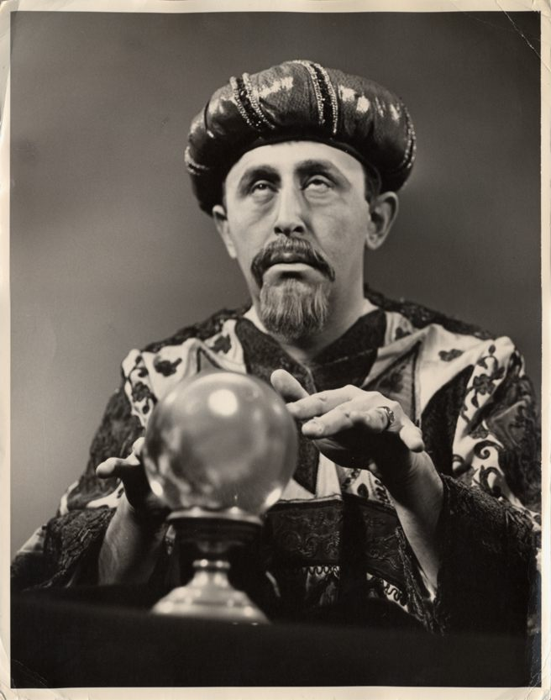
SUMMARY:
The Secret of Literacy

Slide 72
Stand by …

Slide 73
Ready …?

Slide 74
Tension now intolerable … ?

Slide 75
Well, it’s not literacy …

Slide 76
… it’s making the implicit explicit – and modelling it …

Slide 77
… without which, the rich will get richer & the poor will get poorer

Slide 78
… so we could just call it ‘what great teachers do’

Slide 79
Don’t Call it iteracy
Kensington Aldridge Academy
Staff Conference
14 July 2014
Twitter: @RealGeoffBarton
Download this presentation at www.geoffbarton.co.uk
(Presentation number 132)

Slide 80
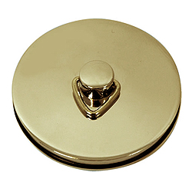
This is an expensive plug ➔

Slide 81
This is a
cheap plug ➔

Slide 82
Don’t Call it iteracy
Kensington Aldridge Academy
Staff Conference
14 July 2014
Twitter: @RealGeoffBarton
Download this presentation at www.geoffbarton.co.uk
(Presentation number 132)

